Slide 1

NOVATECH CASE STUDY

Slide 2
Executive Summary
Nova Technologies – SSH Brute Force Investigation
Nova Technologies, a fast-growing logistics startup in the United States,
recently identified a series of failed SSH login attempts on one of its Linux servers.
In light of this suspicious activity, the company's internal Threat Intelligence team initiated
an in-depth investigation focused on analyzing authentication data from the system’s auth.log file.
Key Objectives of the Investigation:
Detect irregular or unauthorized login attempts from authentication logs.
Identify IP addresses engaging in brute-force attacks against the SSH service.
Cross-reference suspicious IPs with VirusTotal to determine their malicious reputation.
Threat Intelligence Involvement: The Threat Intelligence team played a critical role in identifying and contextualizing the
potential threat. By leveraging log analysis and external threat intelligence tools, the team
was able to uncover patterns consistent with brute-force attacks and assess the risk level of
the involved IP addresses. Their proactive response helped ensure a timely and informed
mitigation strategy, reinforcing Nova Technologies’ security posture as the company continues its growth trajectory.

Slide 3
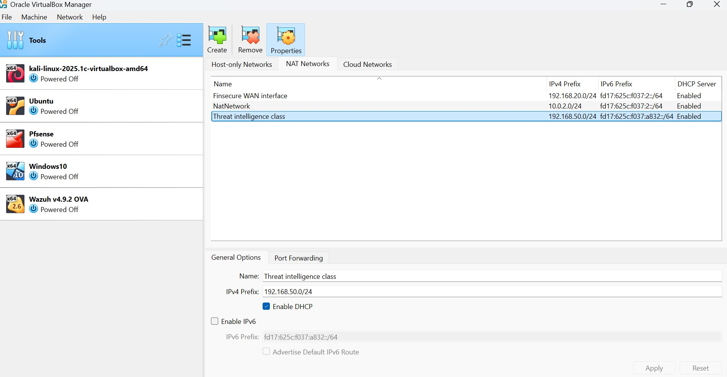
Creation of an additional IP address for Threat intelligence class

Slide 4
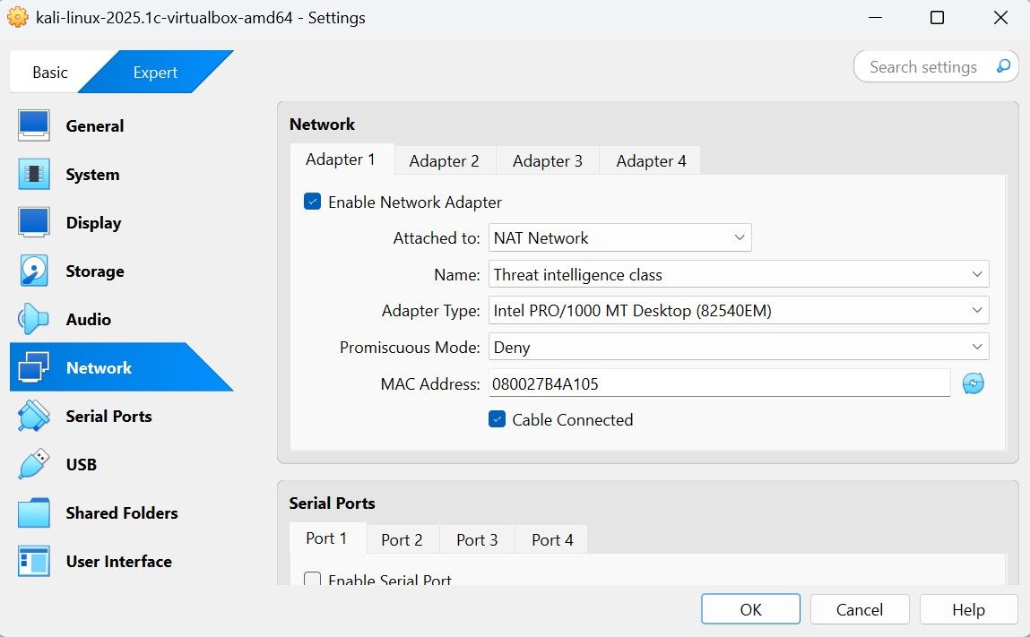
Configuring Kali to the NAT network to receive network

Slide 5
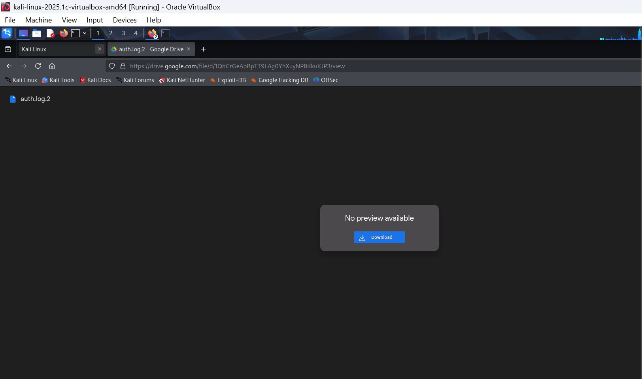
File download: https://drive.google.com/file/d/1QbCrGeAbBpTT9LAg0 YhXuyNP8KkuKJP3/view?usp=sharing

Slide 6
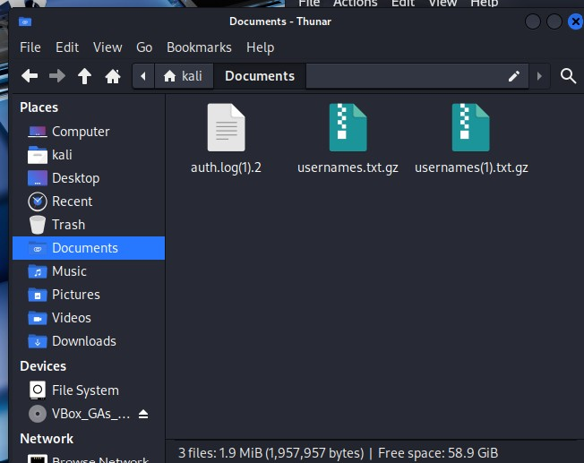
Saved file on documents

Slide 7
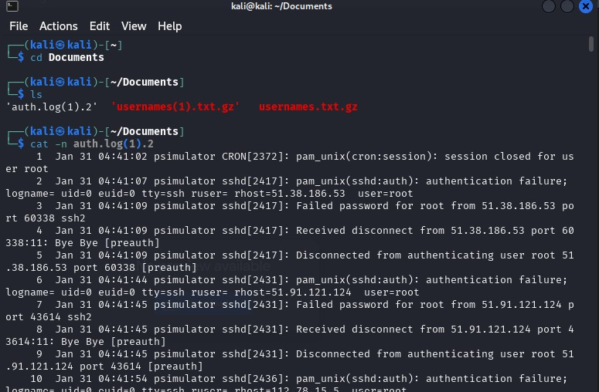
Command to extract documents into CLI

Slide 8
Objectives 1
Detect any unusual login patterns from the auth.log.

Slide 9
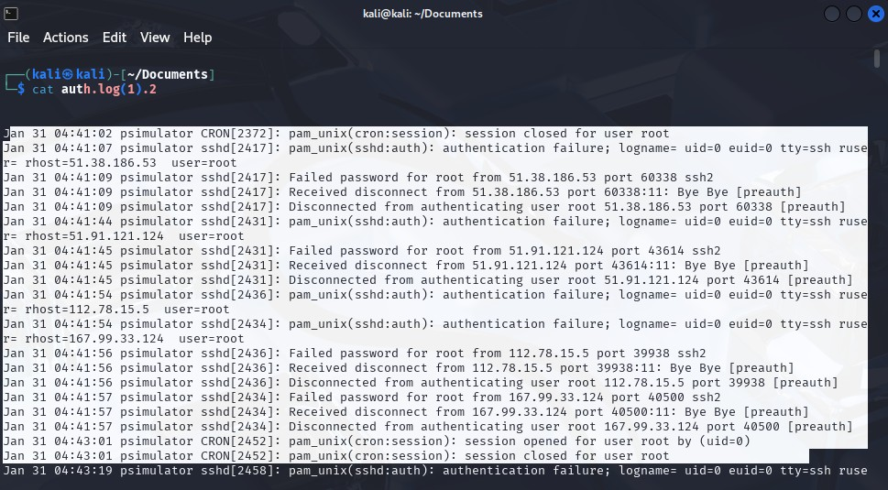
Unusual login attempts due to brute force attacks

Slide 10
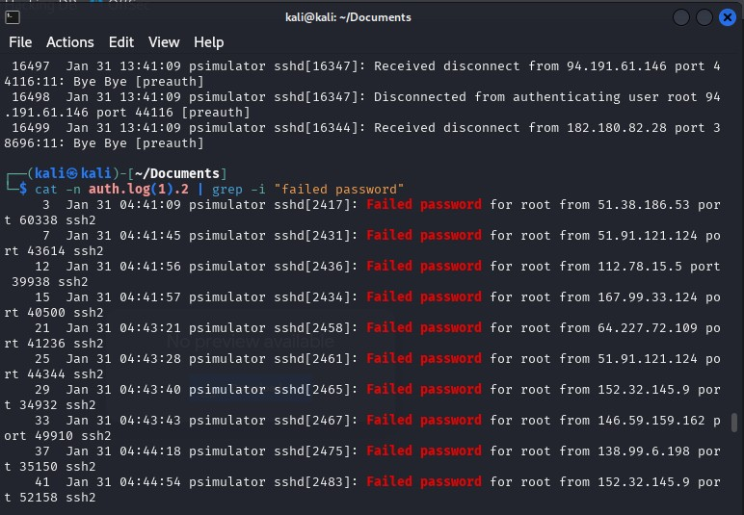
Command to sort the attackers according to failed login password attempts e.g Root

Slide 11
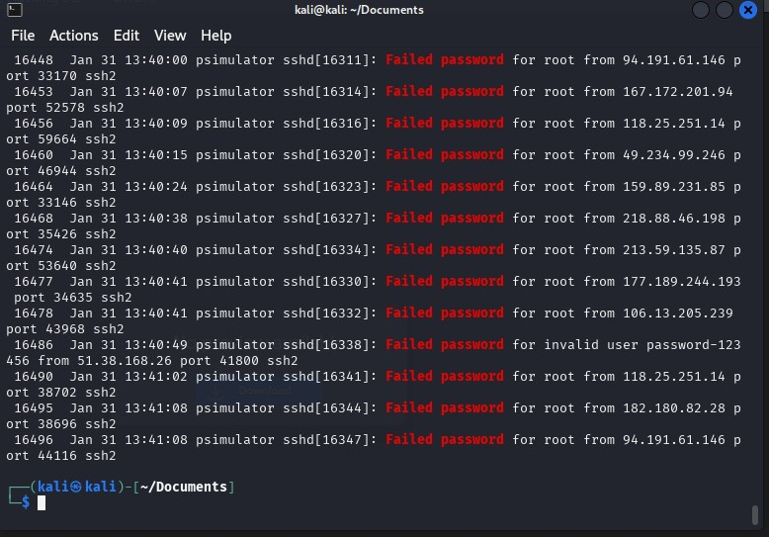
Sorting according to failed password attempts

Slide 12
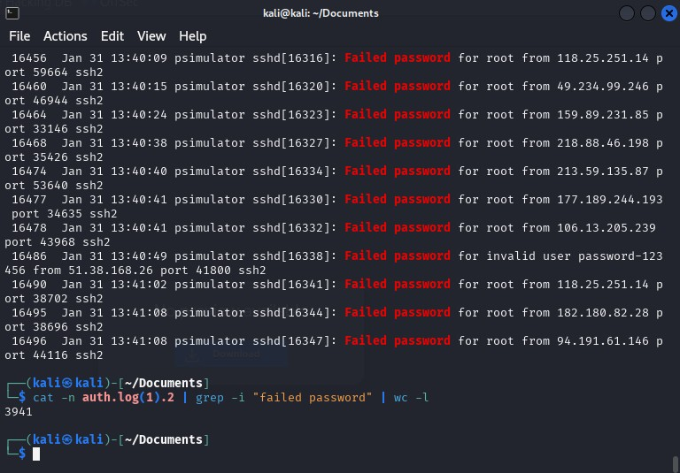
3941 failed password attempts e.g. invalid user, Root.

Slide 13
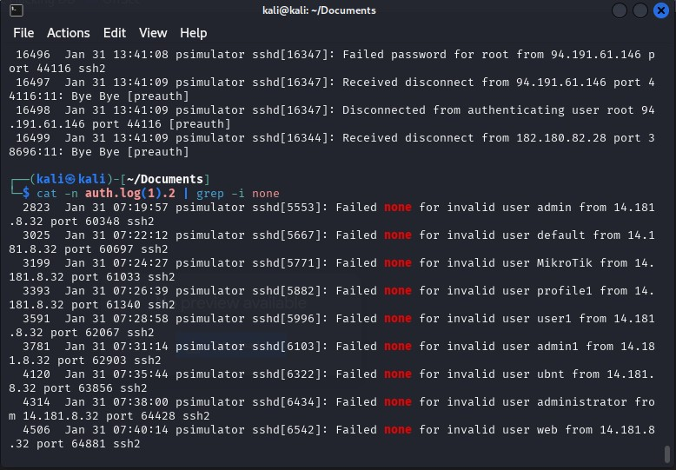
Command to sort the attackers IP address according to none

Slide 14
Objectives 2
Identify IP addresses performing brute-force attacks.

Slide 15
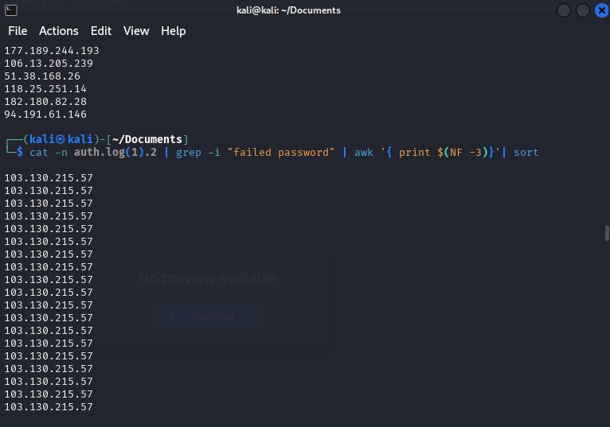
Command to sort the attackers IP addresses

Slide 16
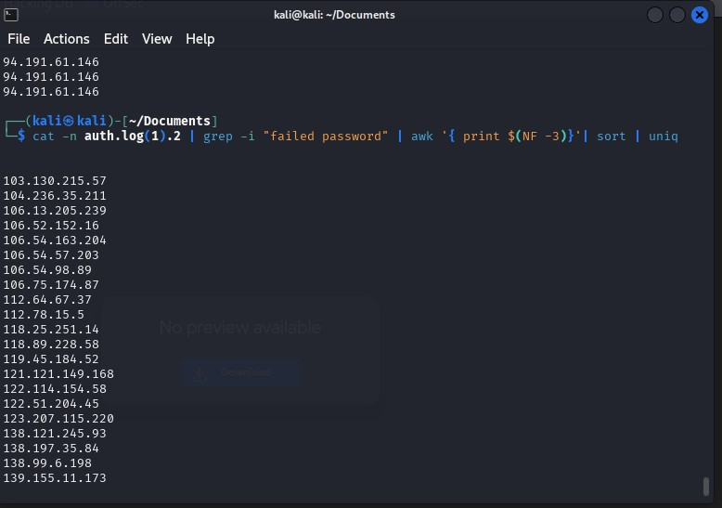
Arrangement according to unique IP addresses

Slide 17
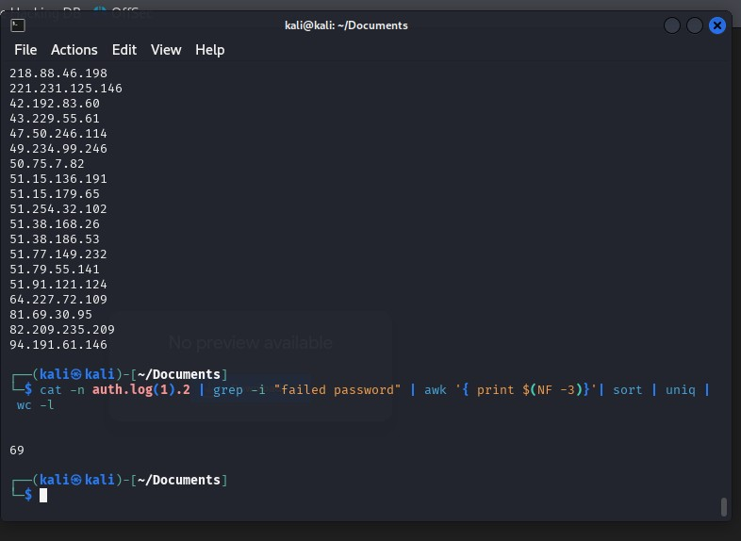
Identifies a total of 69 uniqe IP addresses that failed multiple login attempts

Slide 18
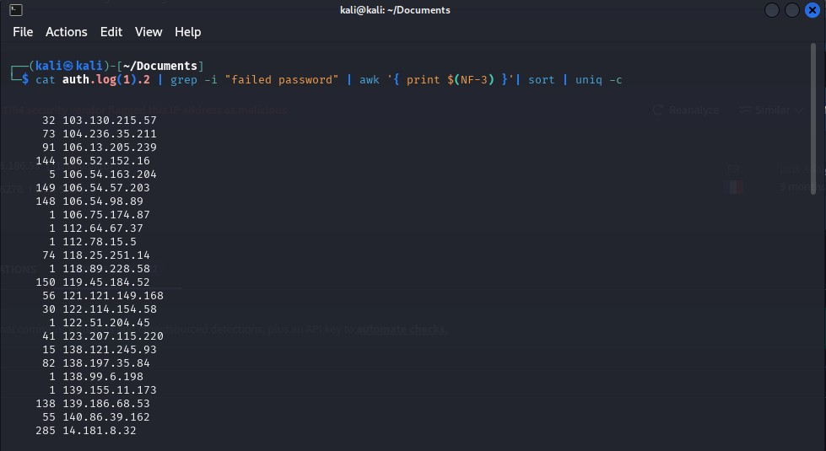
Command showing the IP addresses with total number of brute force attempts

Slide 19
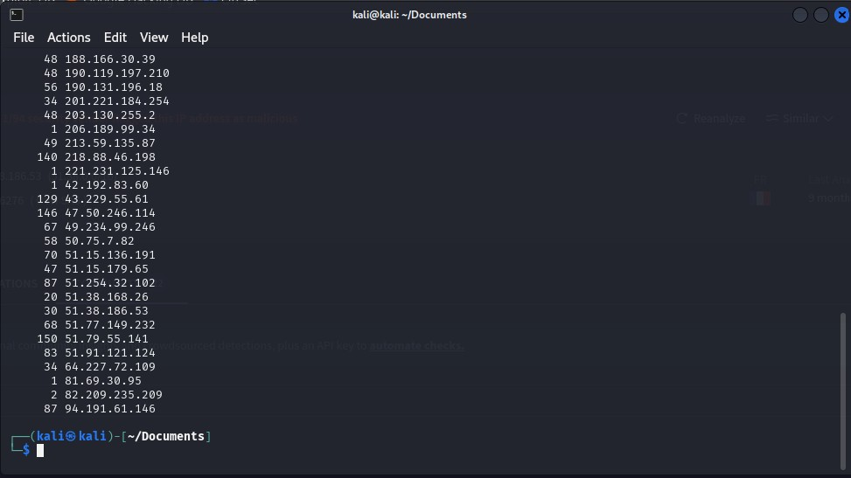
Command showing the IP addresses with total number of brute force attempts

Slide 20
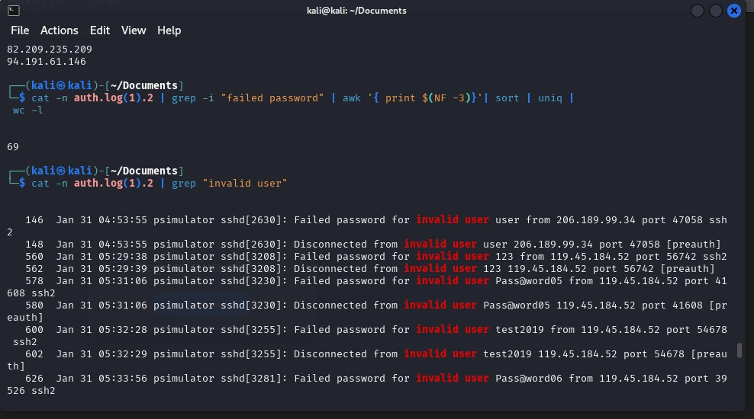
Sorting according to invalid password using grep command

Slide 21
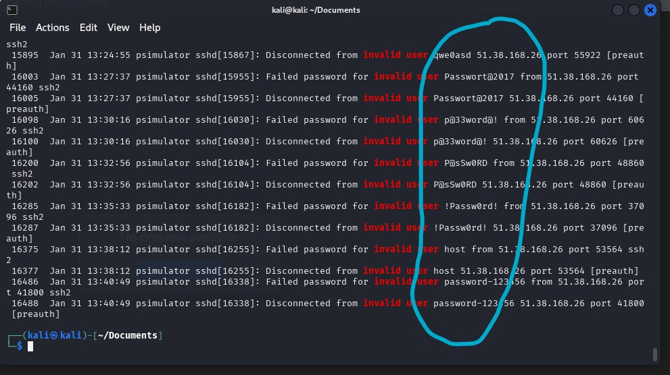
Command showing invalid user and password attempts on accounts

Slide 22
Objectives 3
UseVirusTotal to verify if the IPs are malicious.

Slide 23
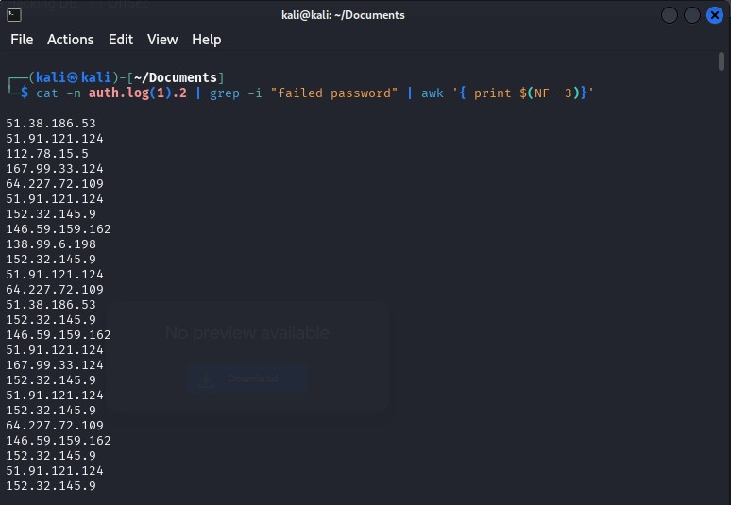
List of IP addresses with failed password attempts

Slide 24
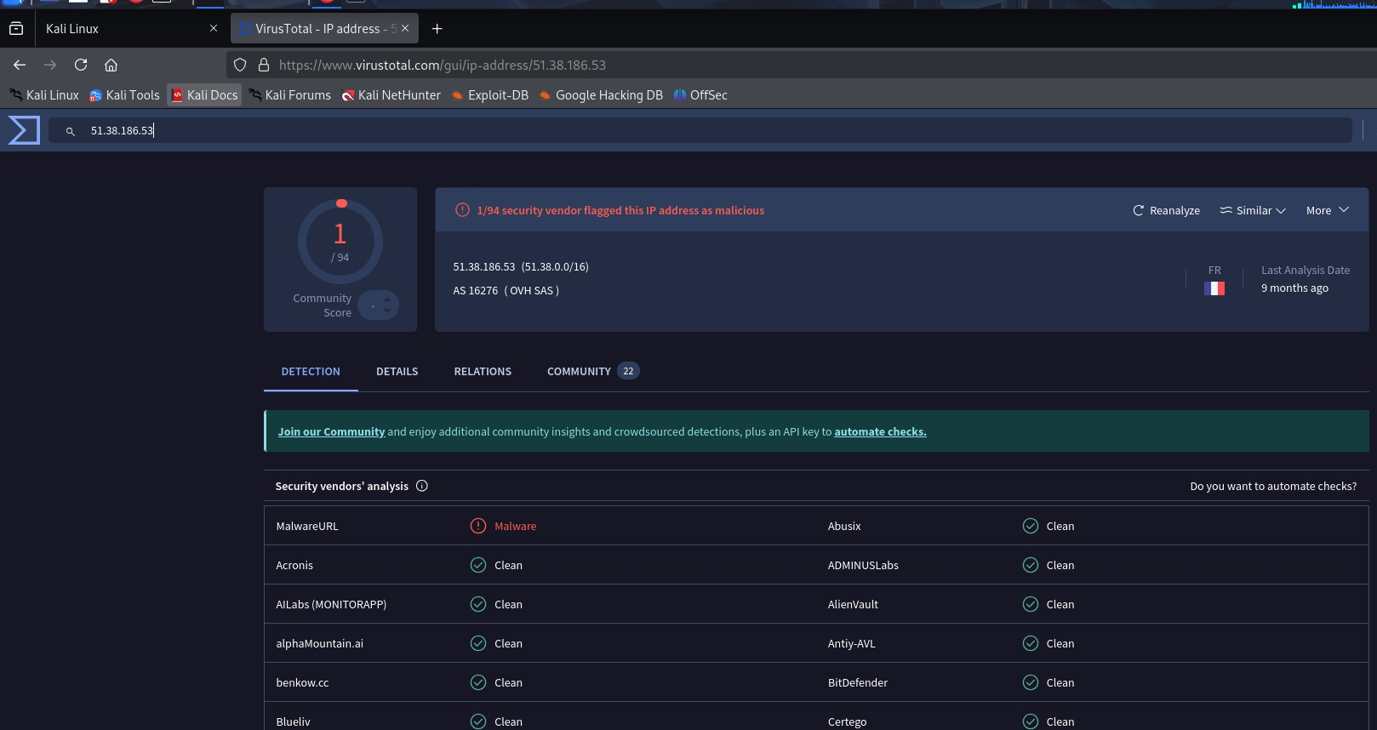
Search of IP address 51.38.186.53 on virustotal

Slide 25
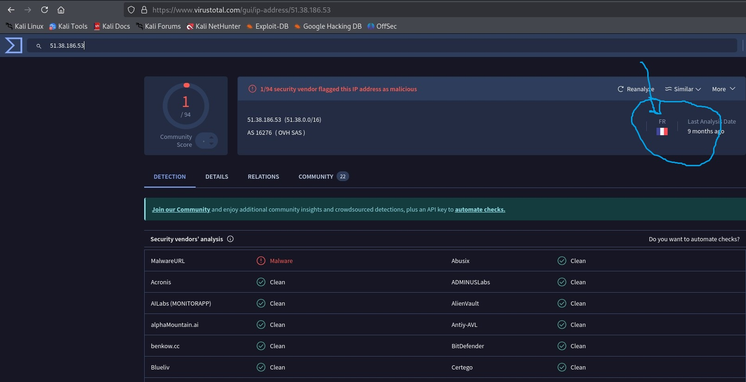
Report showing the location of the IP address

Slide 26
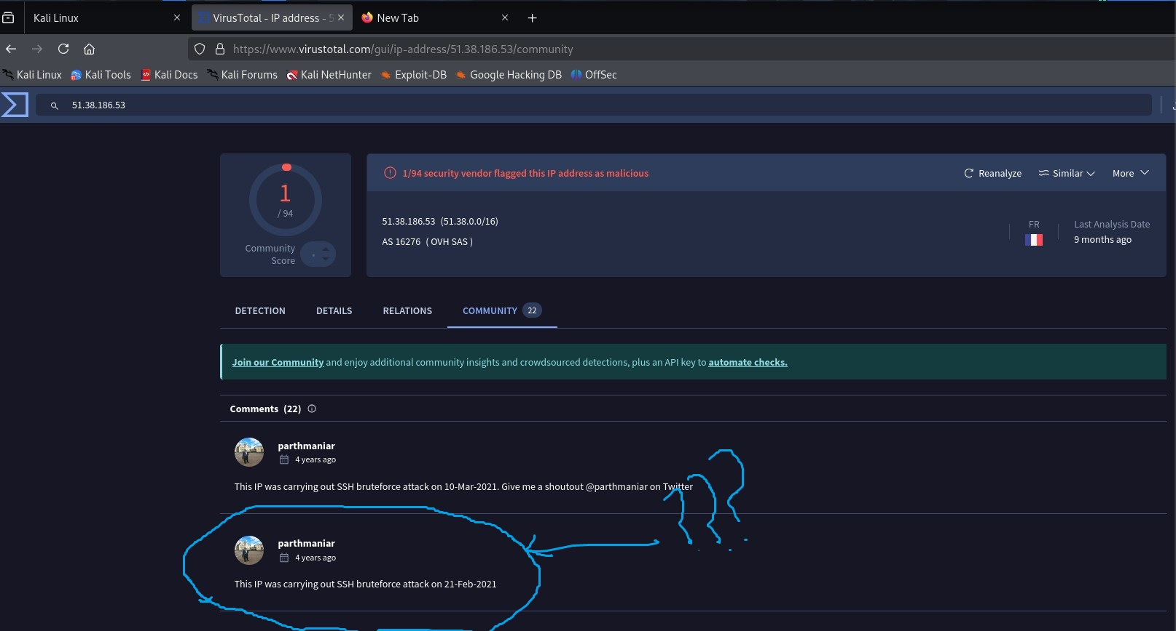
Comment about the IP address on community

Slide 27
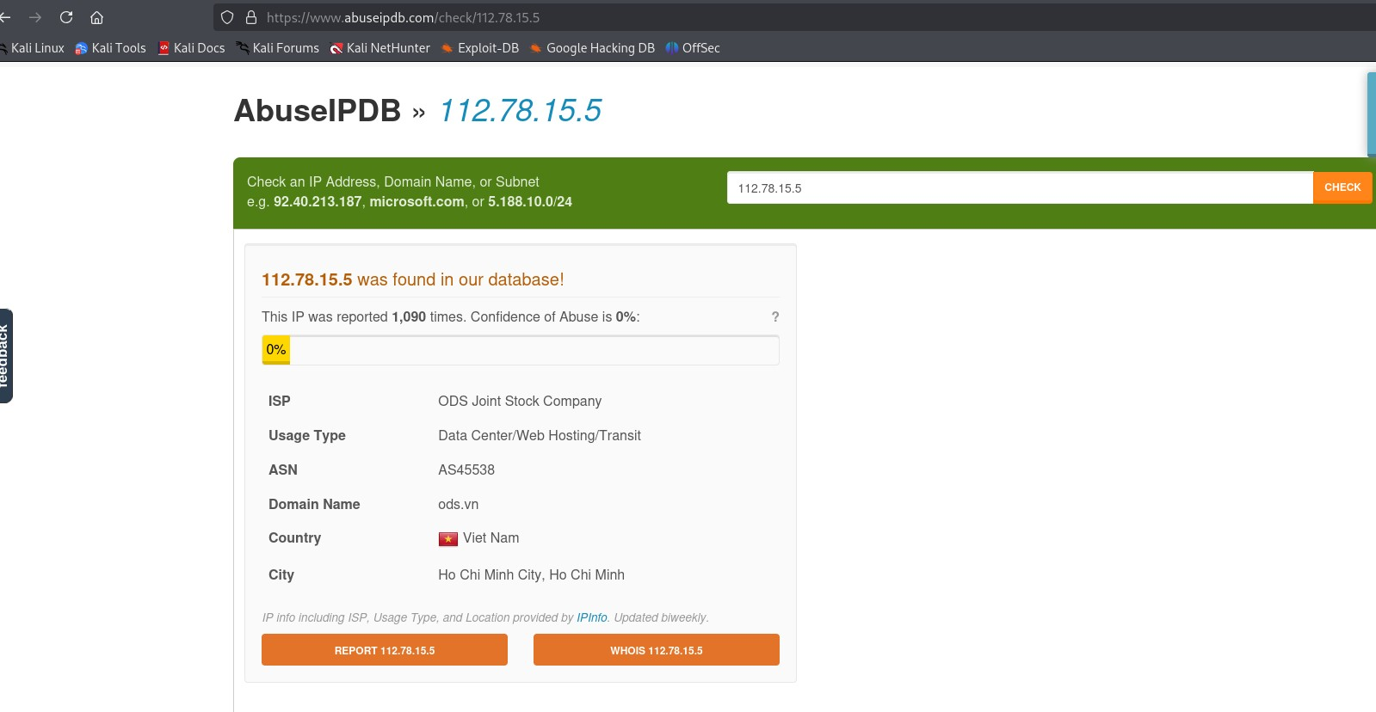
Using Abuse IPDB to check a different malicious IP address 112.78.15.5

Slide 28
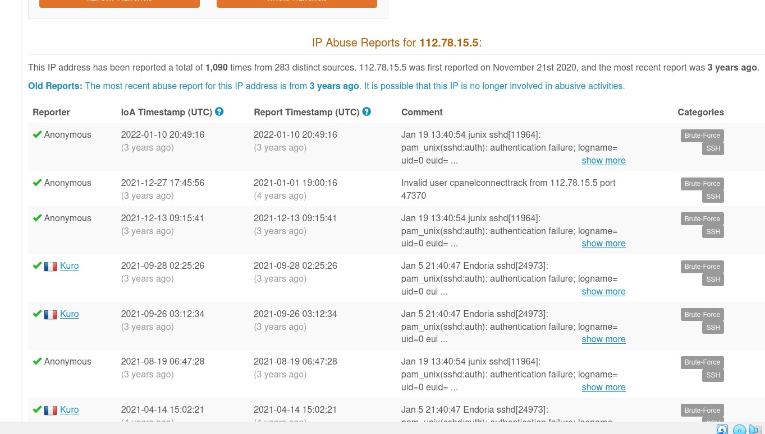
Report on IP address 112.78.15.5

Slide 29
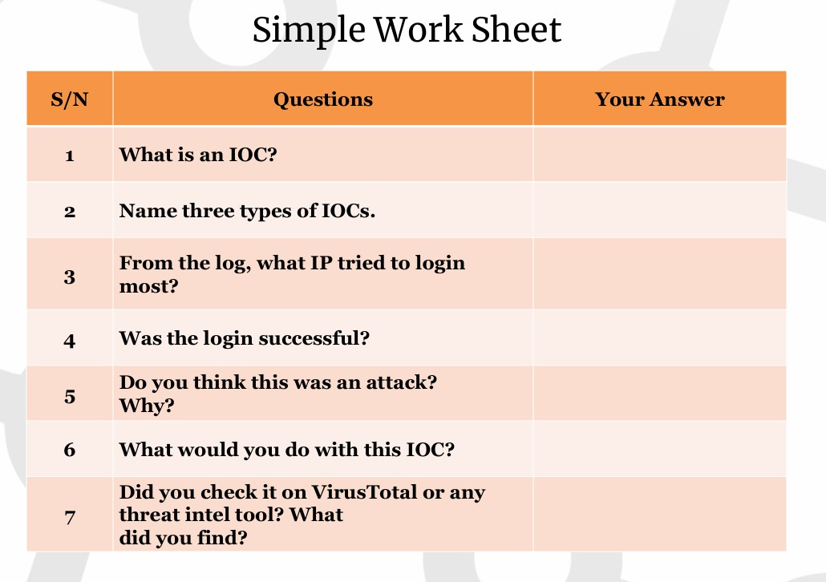

Slide 30
What is an IOC
An Indicator of compromise are attributes that your system or network may exhibit that could lead to the conclusion that there has been an intrusion.
It could be any form of evidence that someone has breached or gained unauthorised access to your systems.

Slide 31
Name three types of IOC
Unusually large amount of network traffic being transferred over a network
Irregular international traffic from foreign IP addresses
Changes to DNS data causing manipulation of where traffic goes on the network

Slide 32
Other types of IOC
Uncommon login patterns into the network at odd hours
Sudden appearance of files on the system.
System lagging or reduction in System efficiency
due to too many attempts, this could be automatically or administratively disabled.
Concurrent login activity, i.e. while being logged in from one facility, in a short amount of time, being suddenly logged in from another location or country.

Slide 33
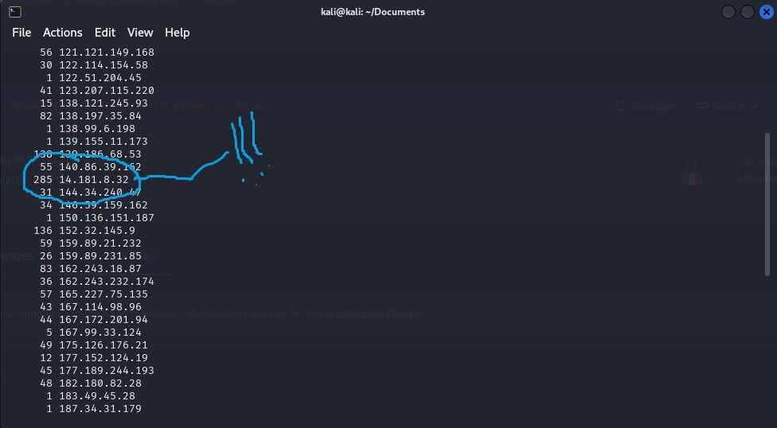
From the Log, which IP address tried to log in the most is 14.181.8.32 with 285 attempts

Slide 34
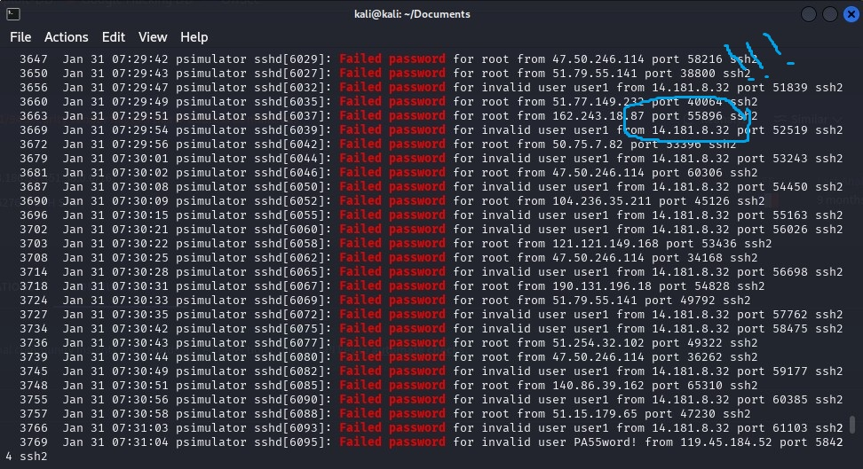
Was the attempt successful

Slide 35
Do you think this was an attack?
Though the attacker has not been previously reported on the various publicly available threat intelligence platforms, and considering the significant indicators of compromise which includes;
Too many login attempts
Irregular login attempts from other countries.
It can be concluded that the attack was indeed malicious and must be effectively mitigated.

Slide 36
What would you do with this IOC?
Risk management
Risk Identification:
Identify the user accounts significantly affected and at risk of attack.
Carry out risk analysis:
Calculate the probability of occurrence and magnitude of impact due
to the risk of an attack.
Risk Mitigation:
Implement encryption of Data at rest and data in transit to ensure confidentiality.
Ensure key stretching and salting to make brute force attacks more challenging for intruders.
Identify the IP addresses carrying the attack and create a deny list on the firewall to block such attackers.
Continuous monitoring:
Use of SIEM Tools like Pfsense to continuously monitor the end points devices and network activities in real time for irregular or suspicious activities.

Slide 37
Did you check it on Virus total or any threat intel tool? what did you find?
There were no significant threats detected as at the time of inquiry

Slide 38
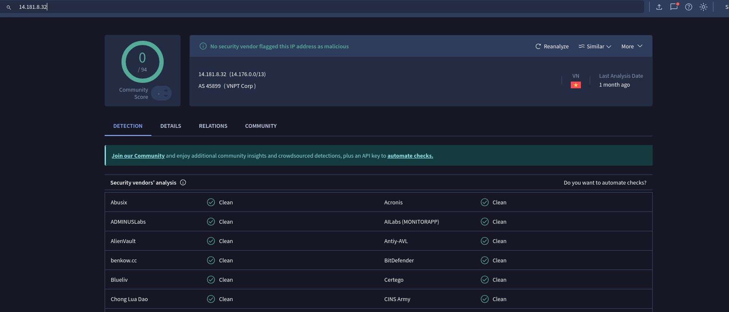
Checking suspicious IP address on virus total – No threat reported

Slide 39
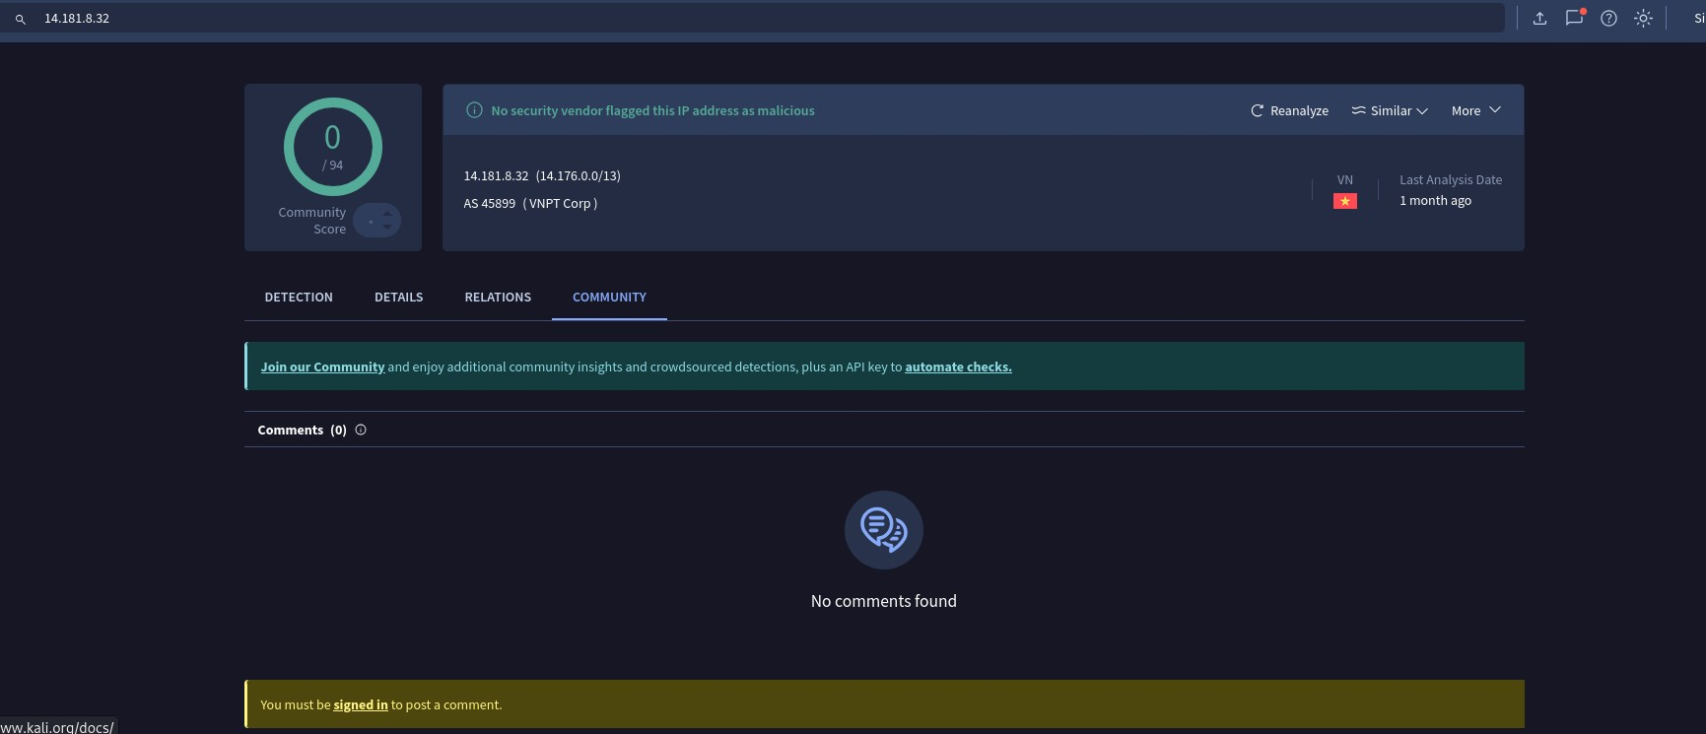
No comments about it on the community

Slide 40
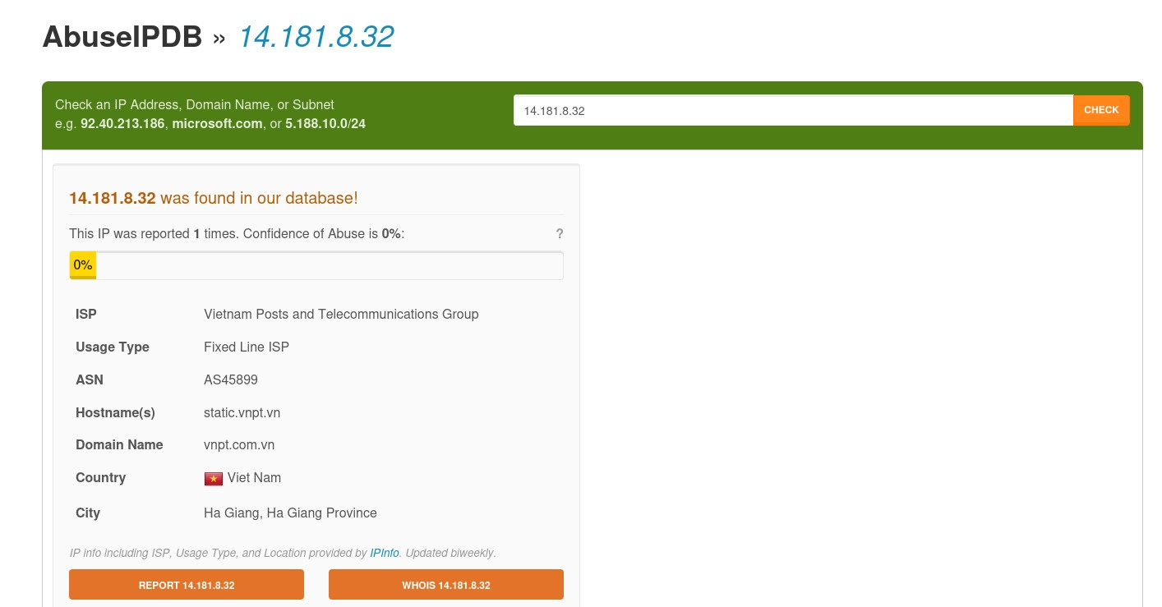
Checked IP address on Abuse IPDB – No significant threat reported

Slide 41


